Slide 1

Data Minders
ABC Pharmaceutical EDA
7-16-2024

Slide 2
Background
ABC is a pharmaceutical company keen on understanding persistency of a drug based on physician prescriptions for patients. To tackle this, ABC has engaged an analytics company to automate the identification of persistency.
Objective : Creating an automated solution to evaluate and enhance the persistency of a drug for ABC.
The analysis has been divided into four parts:
Data Understanding
Data Exploration
Data Transformation
Recommendation

Slide 3
Data Understanding
Features (including derived features): 70
Total data points: 3424
Size of data: 899 KB
Timeline of data:
Type of data: The dataset contains 69 columns, mainly with binary data labeled "Y" or "N," and data types
include 'object' and 'int64'. The target variable, "Persistency_Flag," is binary.

Slide 4
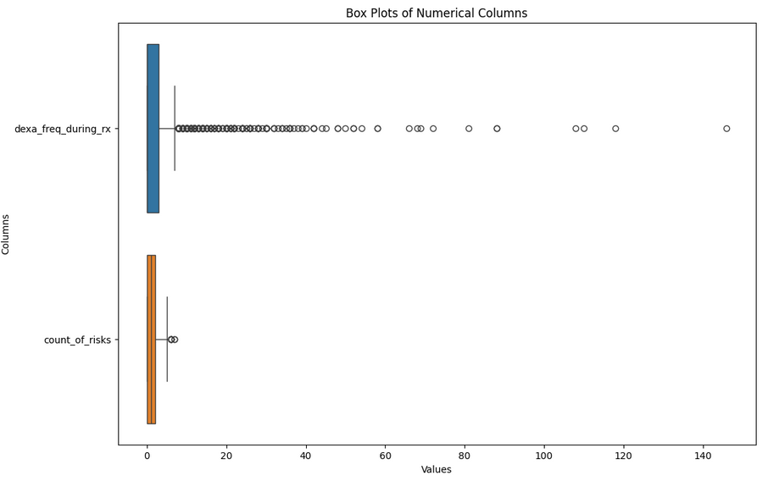
Data Exploration
OUTLIERS: Outliers were found and removed from the dataset, specifically in
'dexa_freq_during_rx' and 'count_of_risks', reducing the dataset size from 3,424 to 2,956 entries.

Slide 5
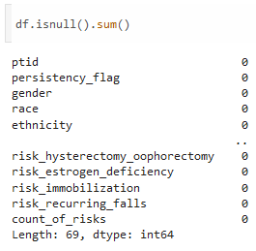
Data Exploration
Missing Values: No missing values ("N/A") were found in the dataset.

Slide 6
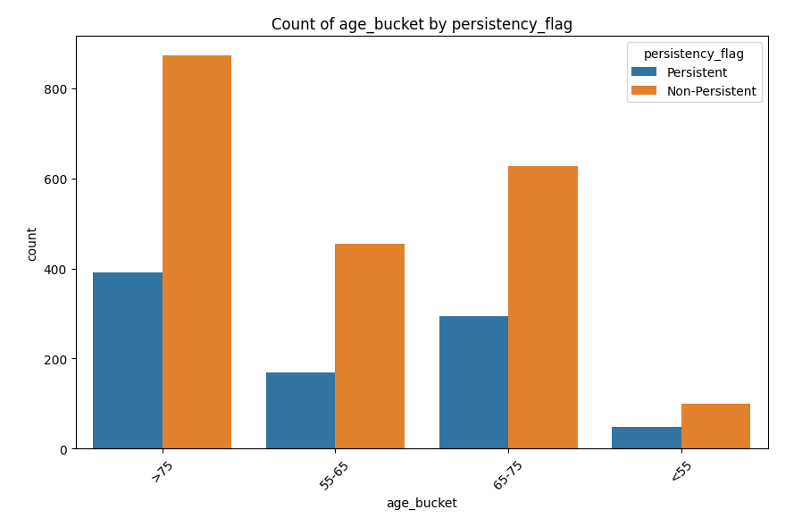
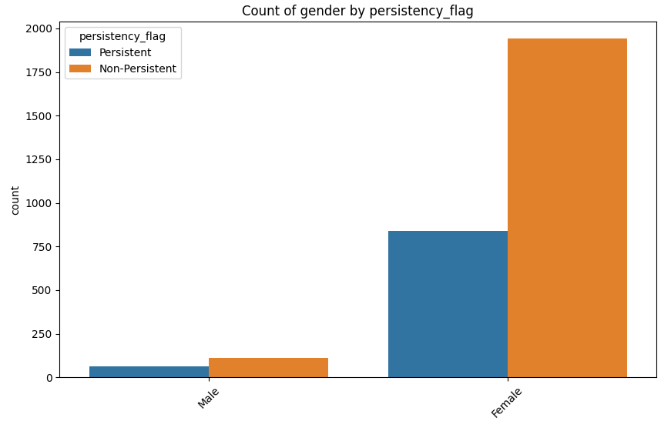
Data Exploration
Gender and age by persistency histograms:

Slide 7
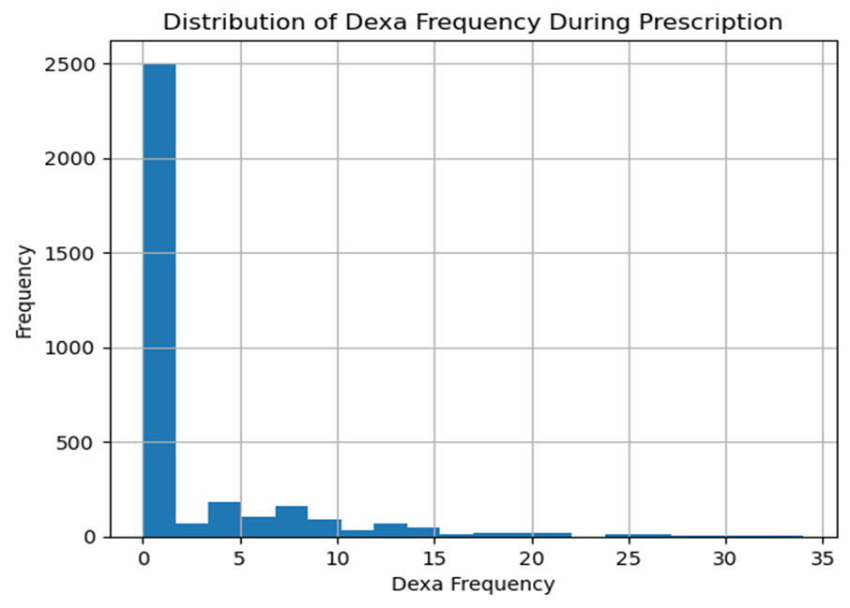
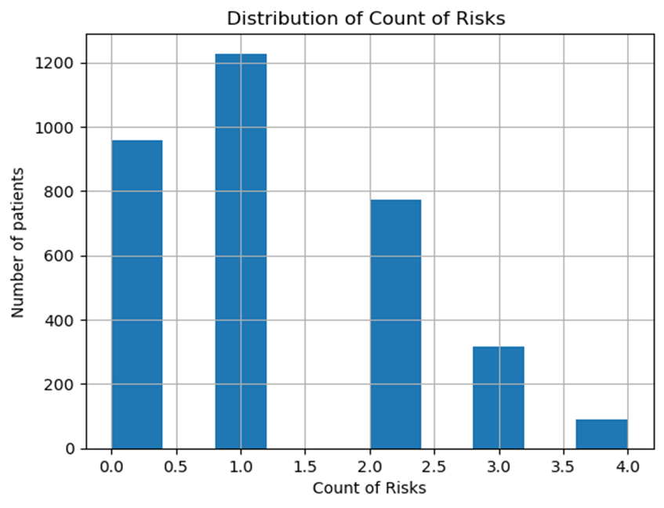
Visualization Results

Slide 8
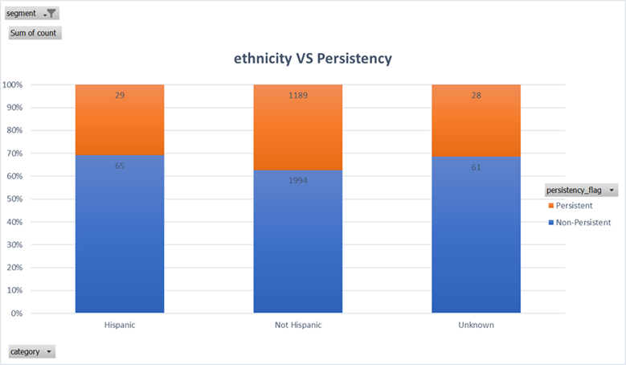
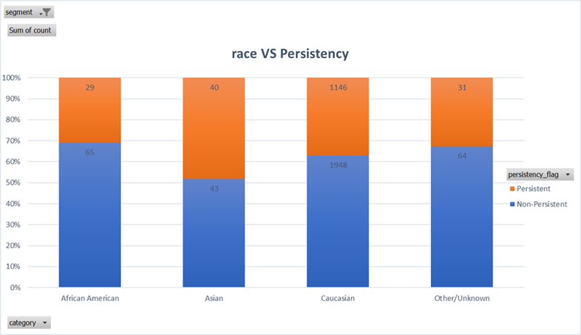
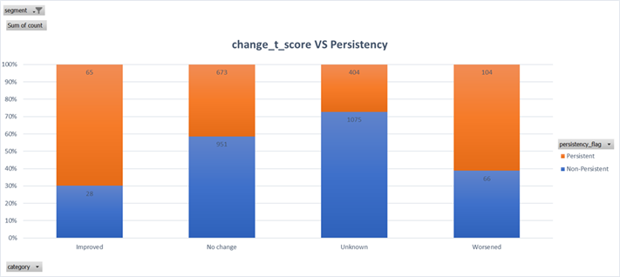
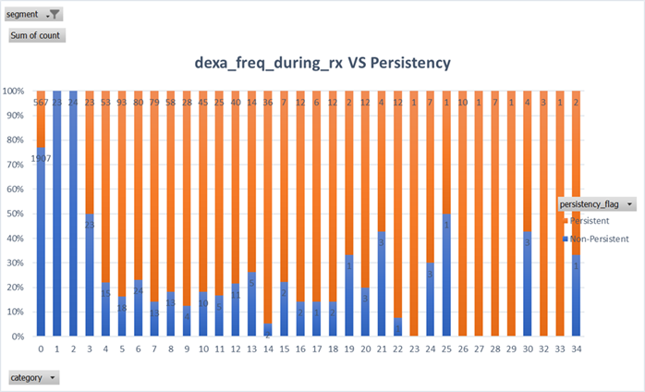
Visualization Results

Slide 9
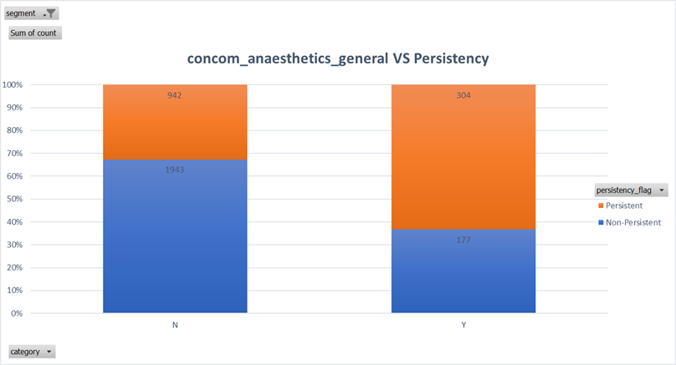
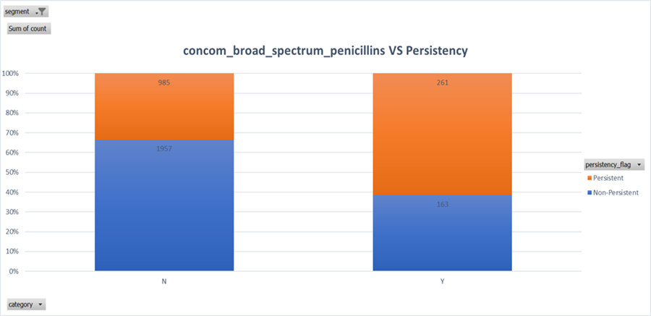
Visualization Results

Slide 10
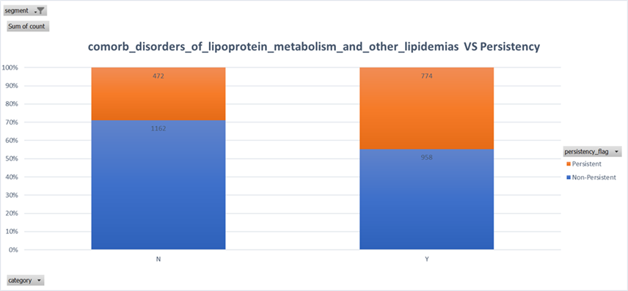

Visualization Results

Slide 11
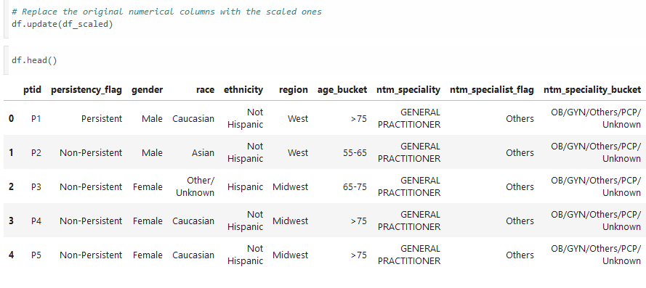
Data Transformation
Scaling: Standard scaling was used to prevent bias and and ensure interpretability.

Slide 12
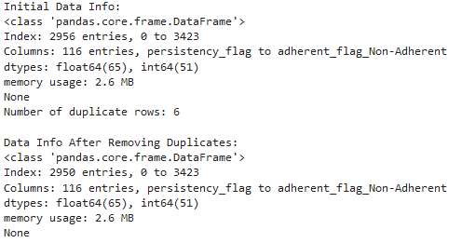
Data Transformation
Duplicates: 6 rows of duplicates were removed total.

Slide 13
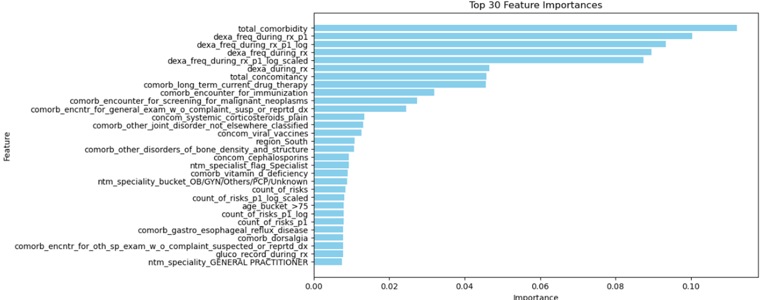
Test Variable Importance by Random Forest Model

Slide 14
Data Transformation
Feature engineering:
•Convert "Y" and "N" to 1 and 0
•Create new Features: total number of concomitancy, total number of comorbidity
•Encoding categorical variables: one-hot encoding
•Scaling and normalization: log transformation
•Feature Selection: drop columns which have no impact on drug_persistency

Slide 15
Recommendations
•The following variables have no impact on drug persistency,
ptid , gender, frag_frac_prior_ntm, gluco_record_prior_ntm,
risk_patient_parent_fractured_their_hip, risk_segment_prior_ntm,
risk_untreated_chronic_hyperthyroidism, risk_estrogen_deficiency,
risk_family_history_of_osteoporosis

Slide 16
Recommendations
Based on the exploratory data analysis (EDA) results and the insights from the Phik matrix, it is planned to develop robust predictive models with special attention to addressing multicollinearity and class imbalance. Multicollinearity, identified using the Phik matrix, is intended to be mitigated through methods such as Principal Component Analysis (PCA) and regularization (Lasso and Ridge), which will help adjust coefficients and enhance model stability. To address class imbalance, techniques such as SMOTE will be applied to increase the representation of the minority class or adjust class weights algorithmically within the model. Algorithms suitable for binary classification, such as logistic regression, decision trees, and ensemble methods like random forests and gradient boosting machines, are planned due to their reduced sensitivity to multicollinearity and effectiveness in handling class imbalance. To fine-tune model parameters and assess their effectiveness, cross-validation and performance metrics such as precision, recall, and AUC-ROC are intended to be used. These measures will ensure that the predictive modeling efforts are based on sound statistical principles and best practices.

Slide 17
Thank You

